Slide 1
Analog VLSI
Session No. 01
Lab+Skilling
Dr. Vijay Rao Kumbhare
Assistant Professor (ECE)
K L University, Hyderabad

Slide 2
Introduction to Cadence Virtuoso

Slide 3
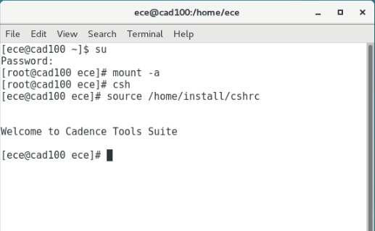

How to start Cadence Virtuoso
Open Terminal
Use the following Command into terminal
mount -a
csh
source /home/install/cshrc
Virtuoso &

Slide 4
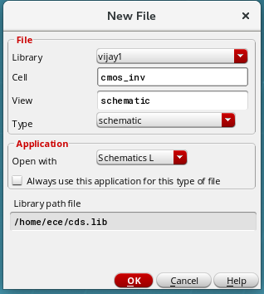
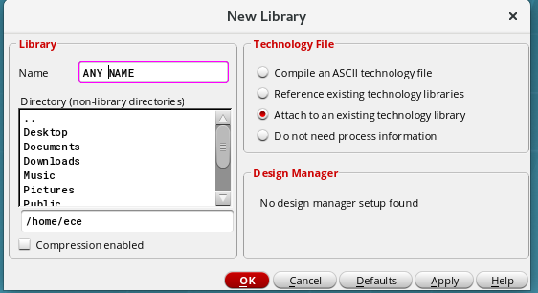
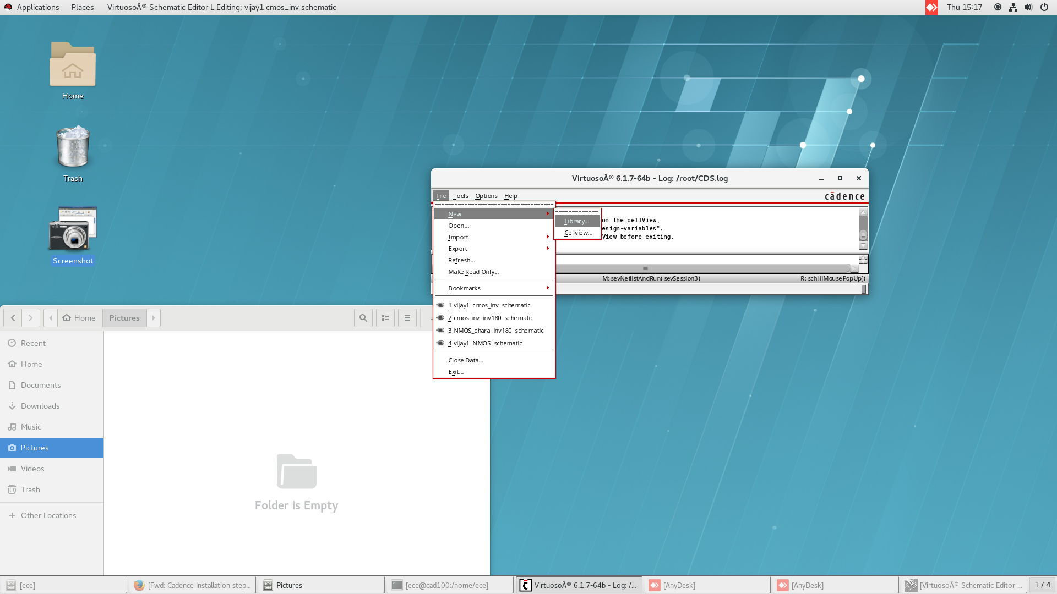
Steps to start
Again go to File→New→ Cellview

Slide 5
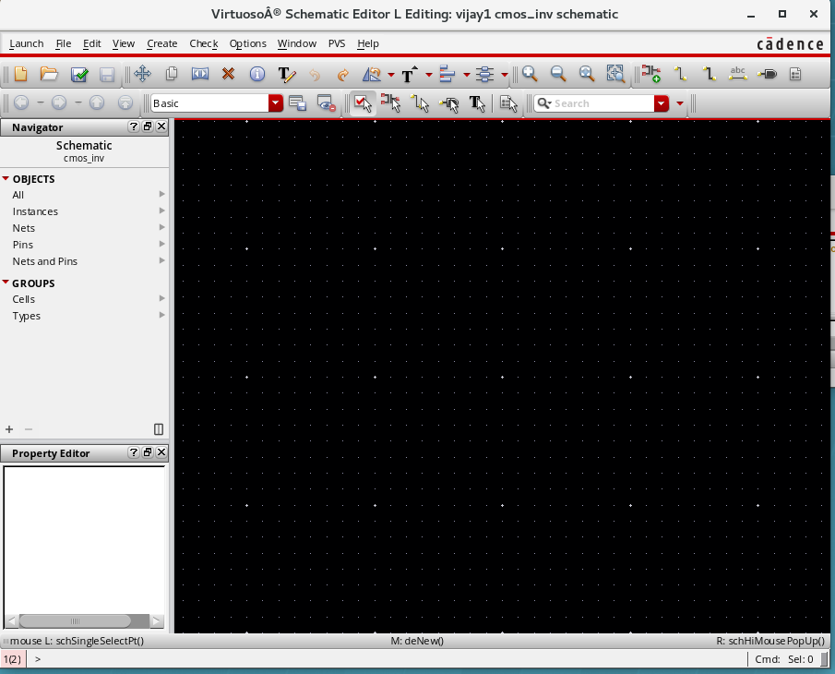

Slide 6
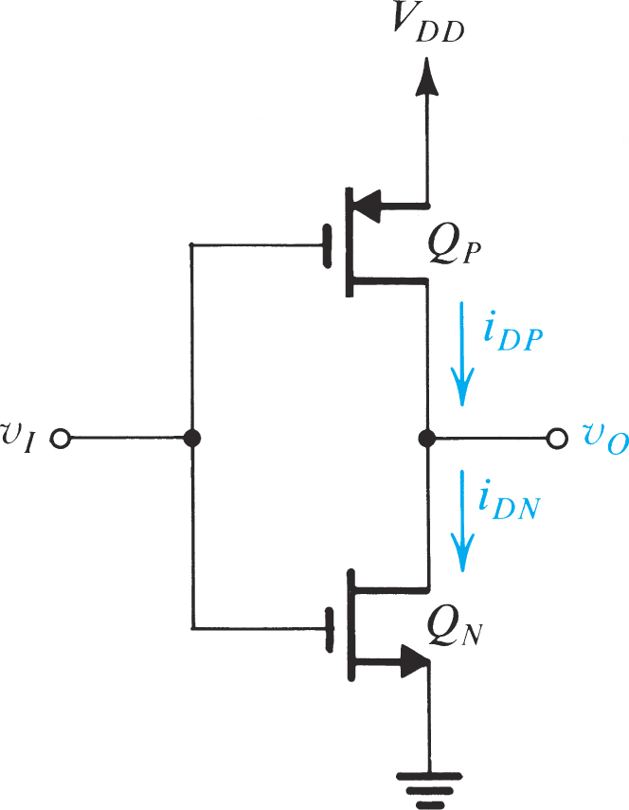
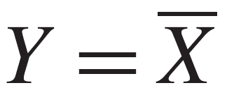
Task-1 CMOS Inverter
Figure 1

Slide 7
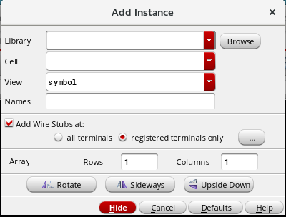
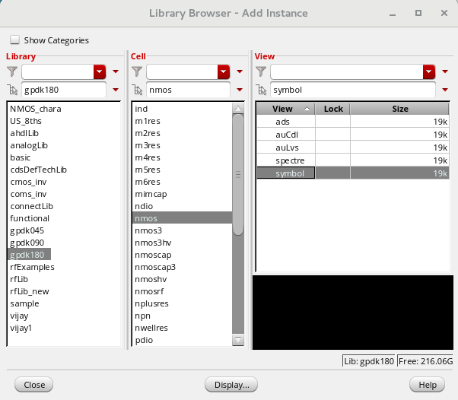
Some basic things to know
To access components→ Create → instance or Press I
Use Library based on technology requirement →

Slide 8
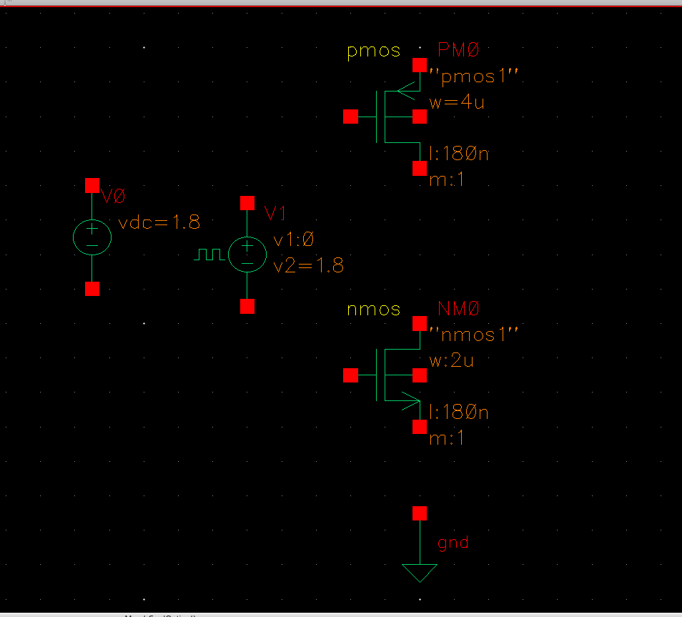
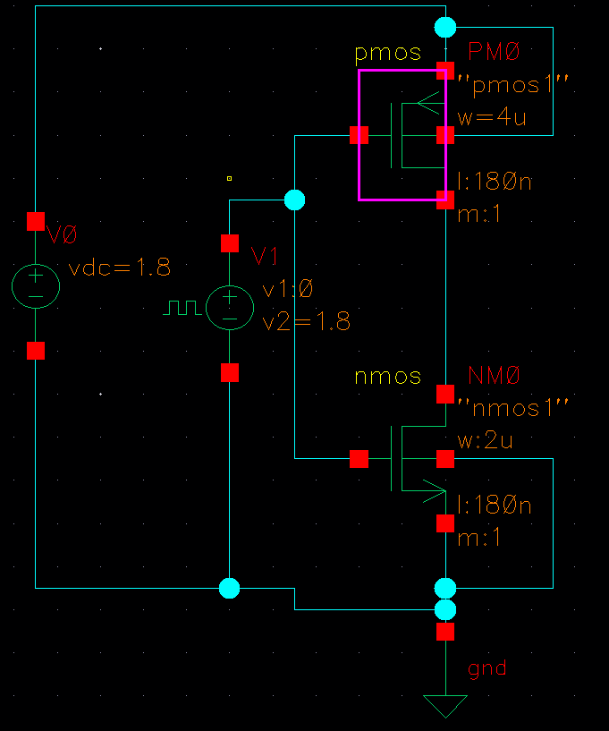
Label the input and output →Create wire name
Once it is done → Check and Save
Go to Launch → ADE L

Slide 9
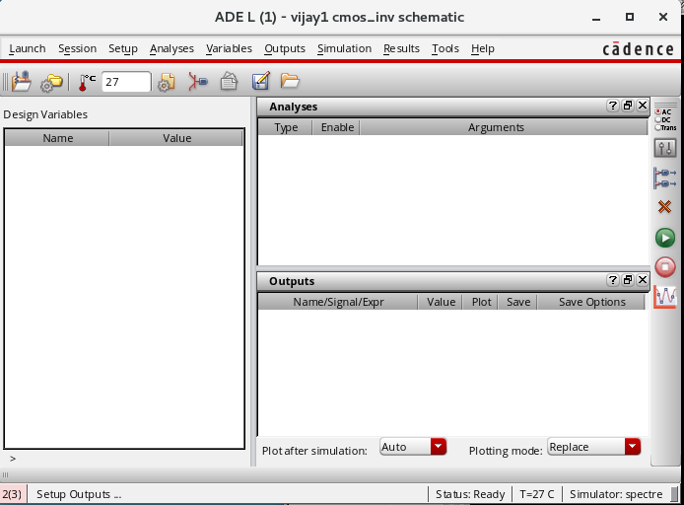
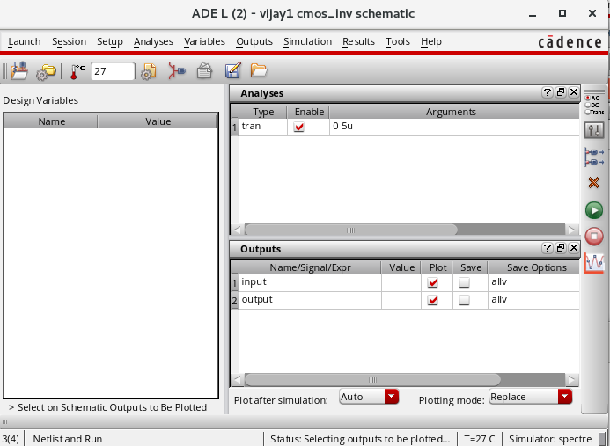
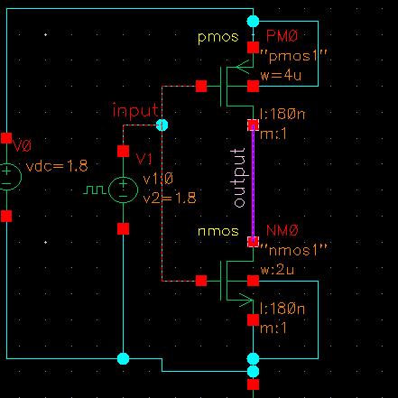
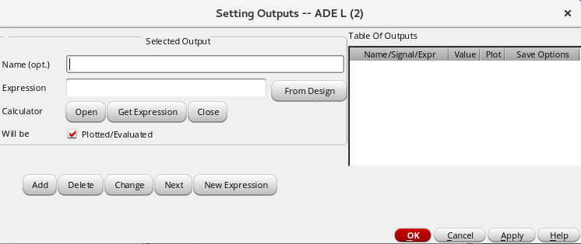
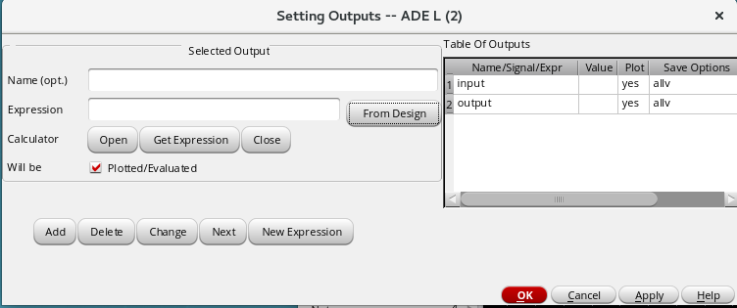
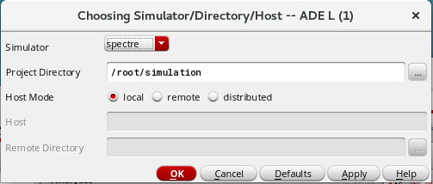
Choose Different analysis
Setup the output
To run the simulations
Setup → Simulator/DirectoryHost → Spectre

Slide 10
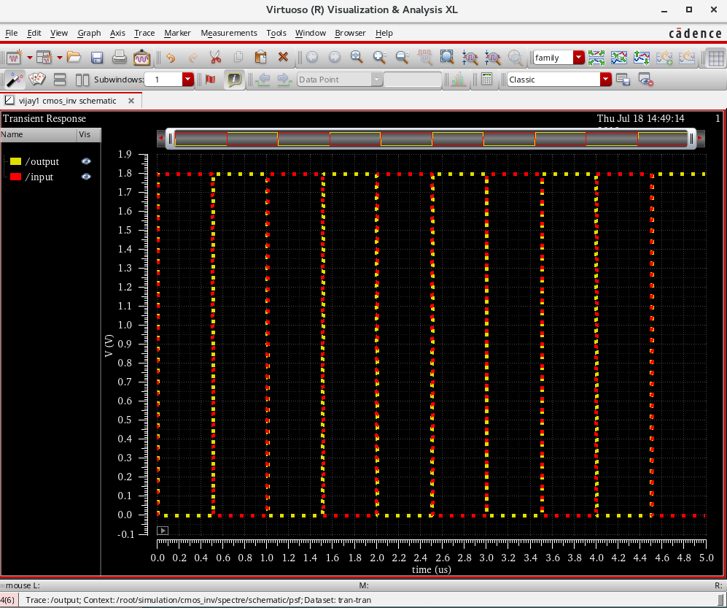

Slide 11
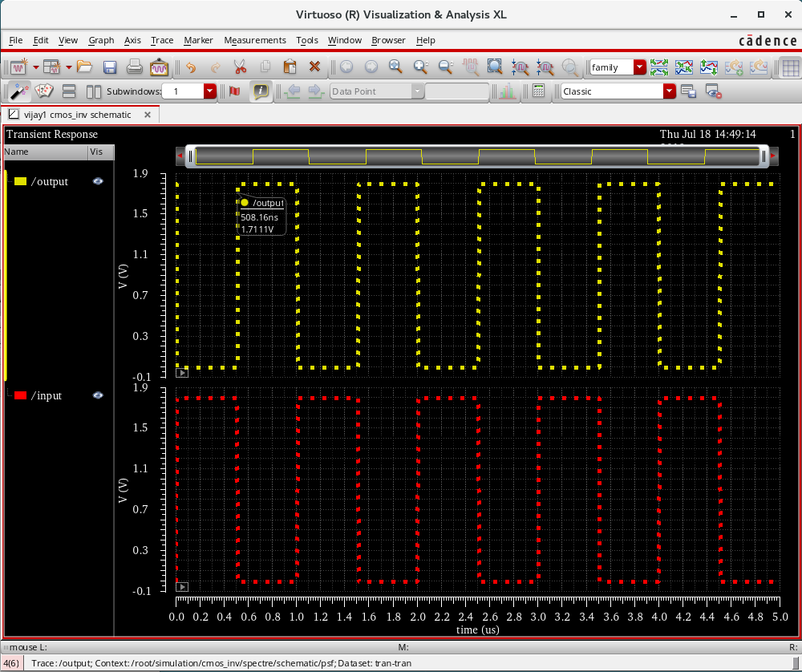

Slide 12
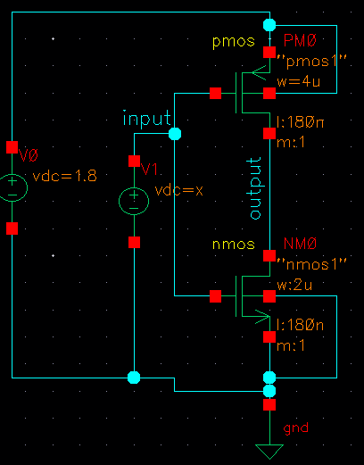
For Voltage Transfer characteristics
Change the source into Vdc
Check and Save→ ADE L

Slide 13
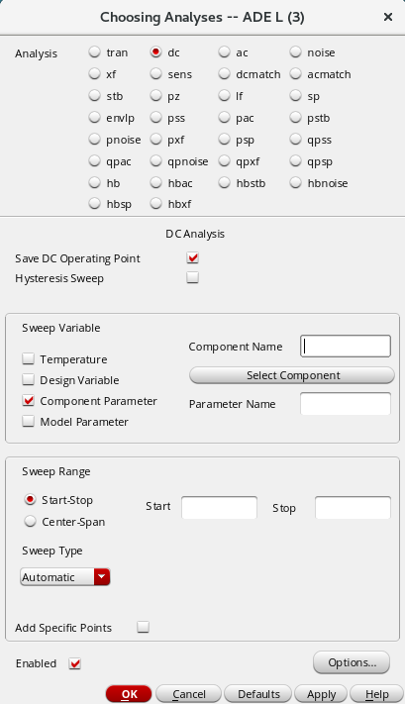
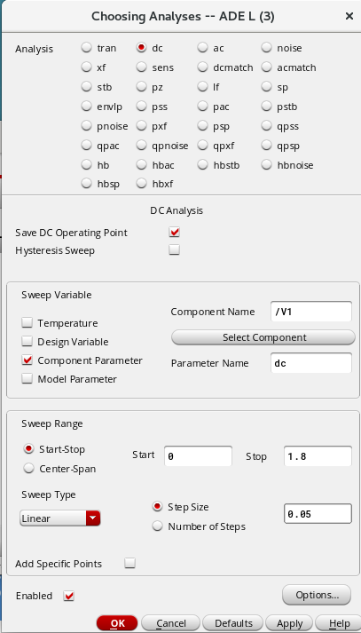
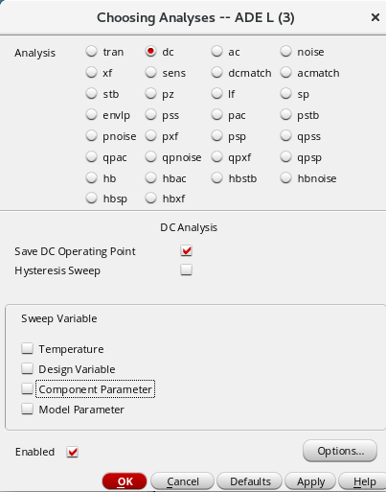
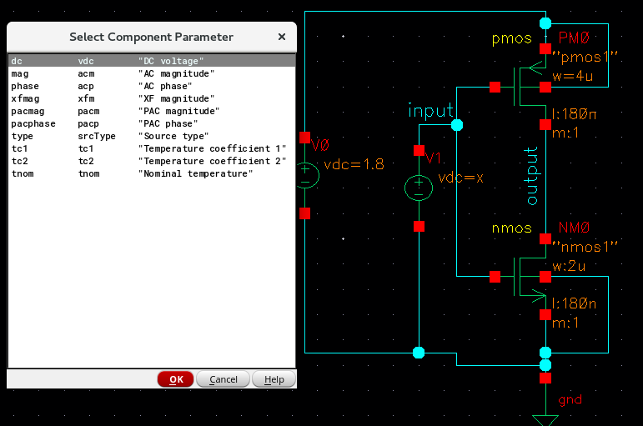

Slide 14
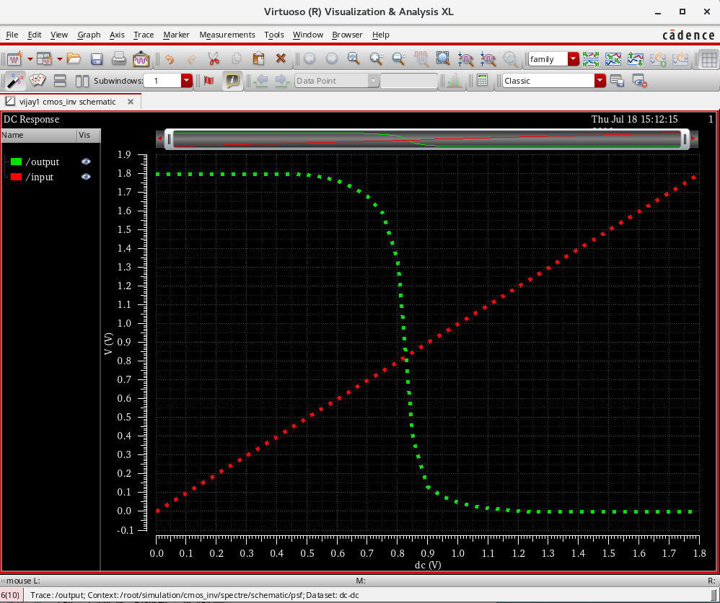
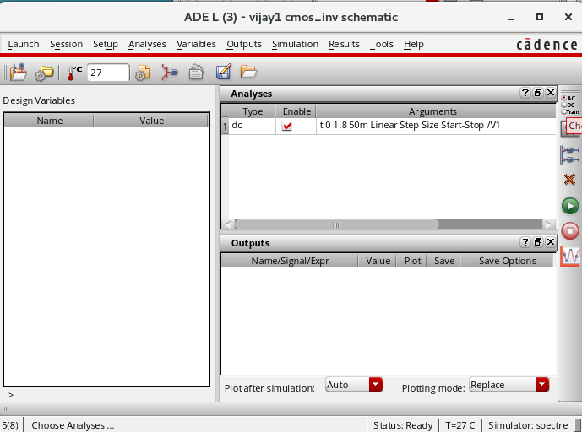
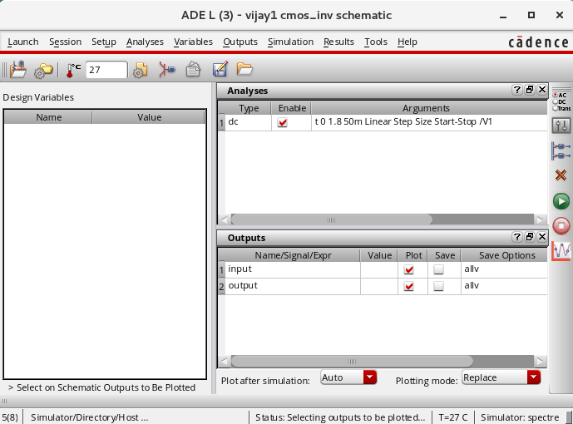
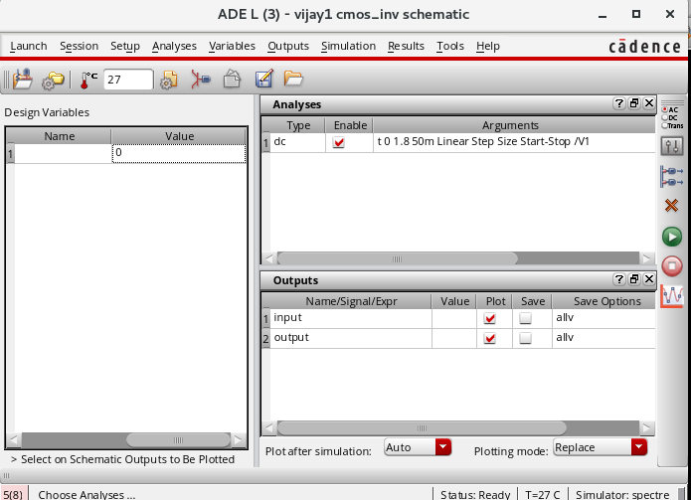
Setup output → Choose Input and output terminals
Variable→ Copy From cellview
Run the simulations

Slide 15
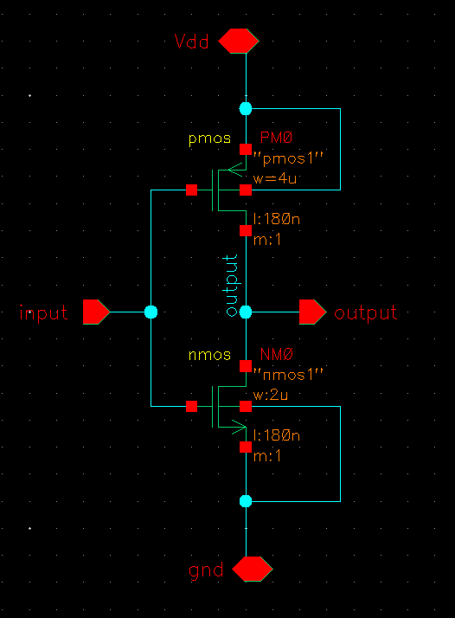
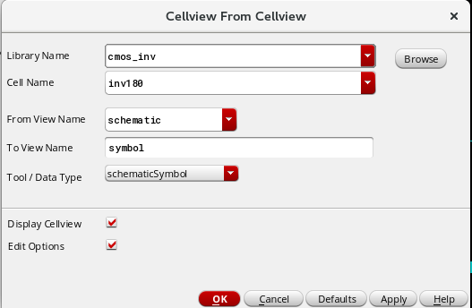
How to create logic symbol
Check and Save
Create→Cellview→From cellview

Slide 16
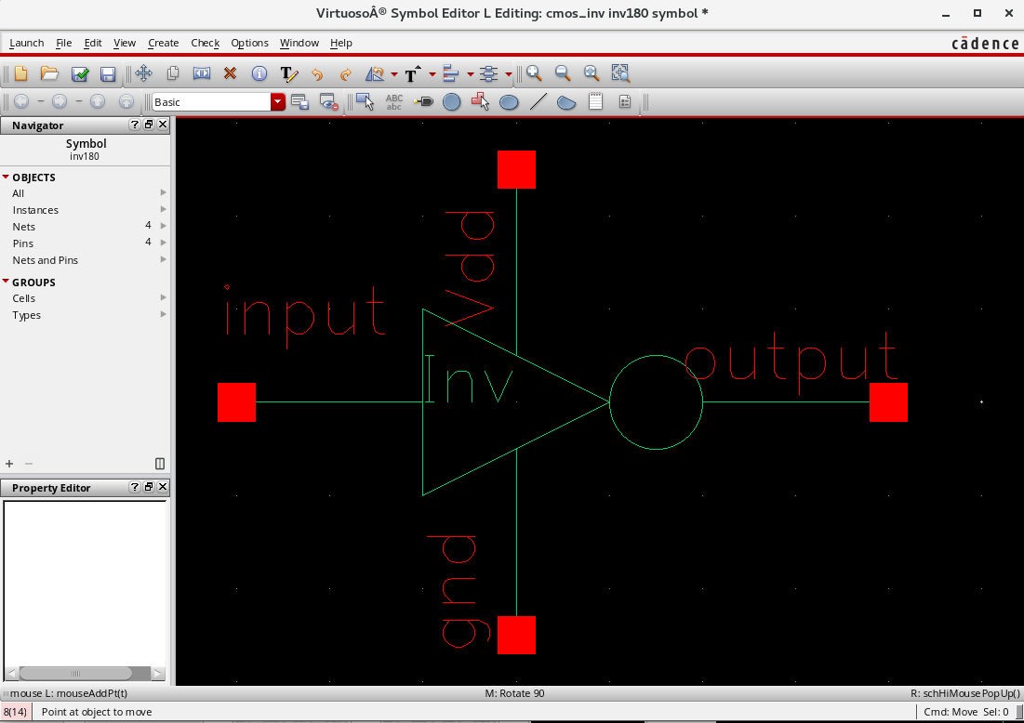
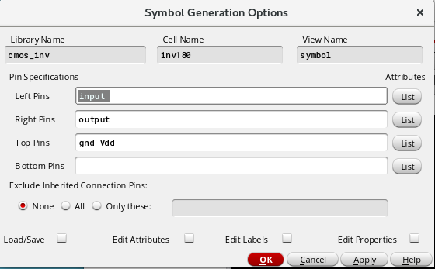
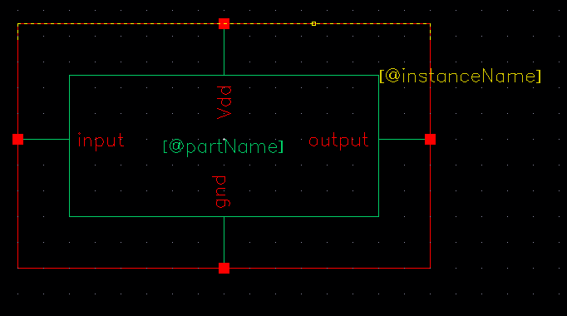
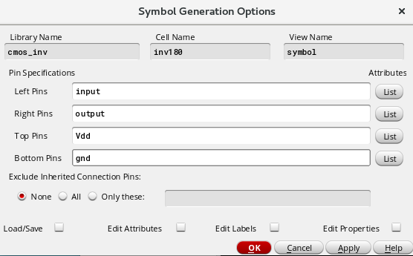
Change it
Check and Save→ Close it
Check the library Manager

Slide 17
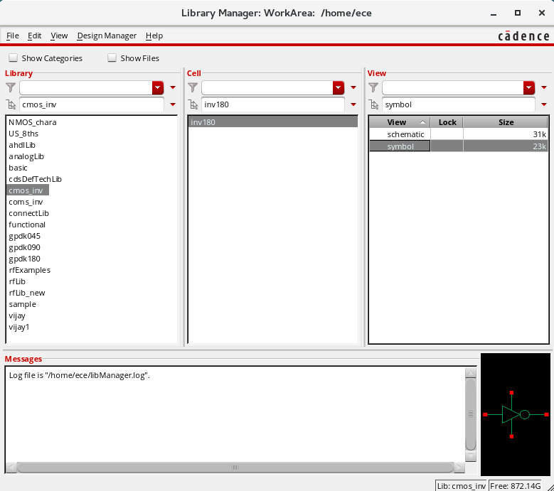
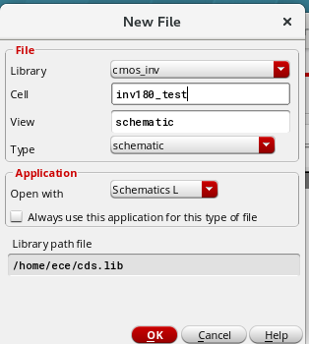
File→ New→Cellview→name it “inv180_test”

Slide 18
Thank you

